Slide 1
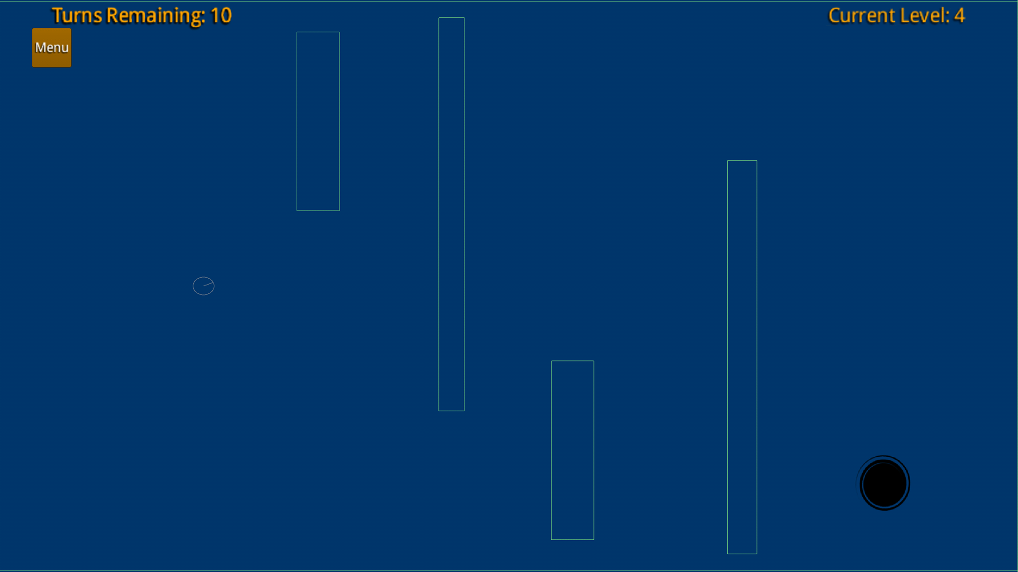
The Ball Game
21238D Gouhe001, Malty003, Nguty218

Slide 2
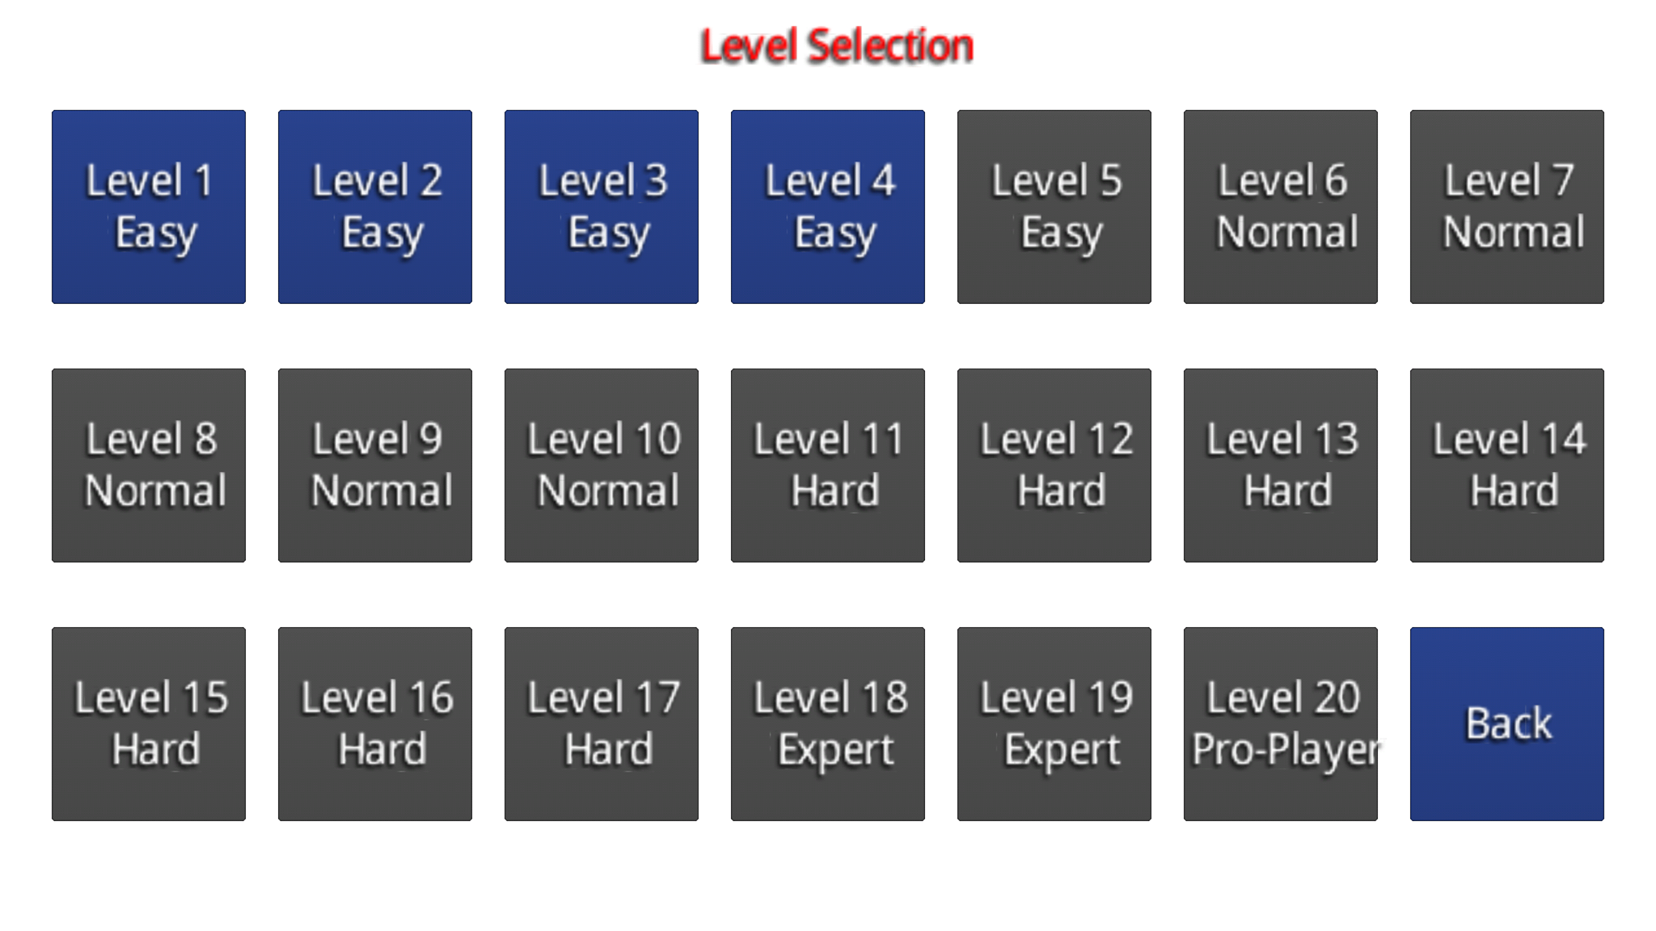
Mechanics
The player moves the ball around using touch inputs
The ball constantly rotates to add direction to the ball movement
The ball bounces off of obstacle walls to stall the player from getting to the goal
Many of the obstacles move around for added difficulty
Each level has a set amount of turns to be able to complete the level in
Once you have reached the goal you immediately progress to the next level

Slide 3
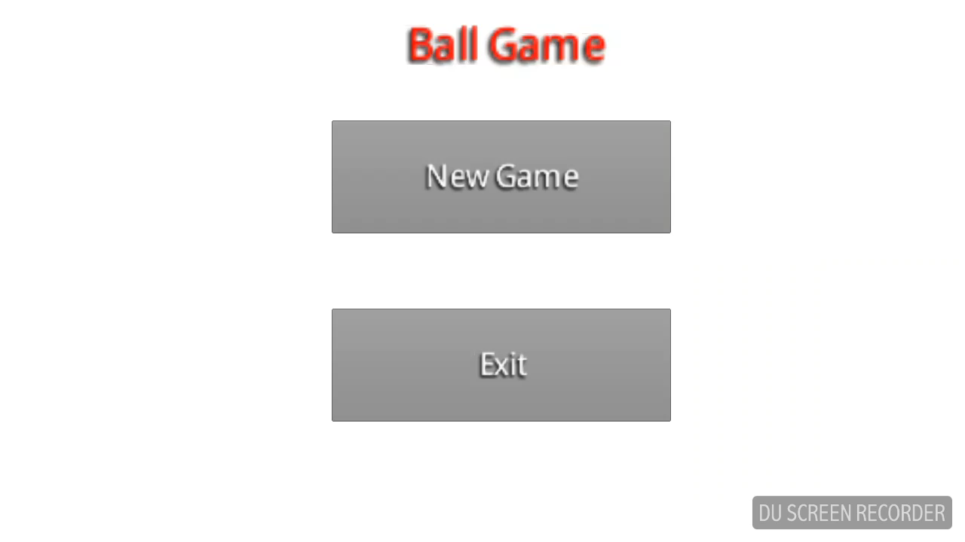
Demo

Slide 4
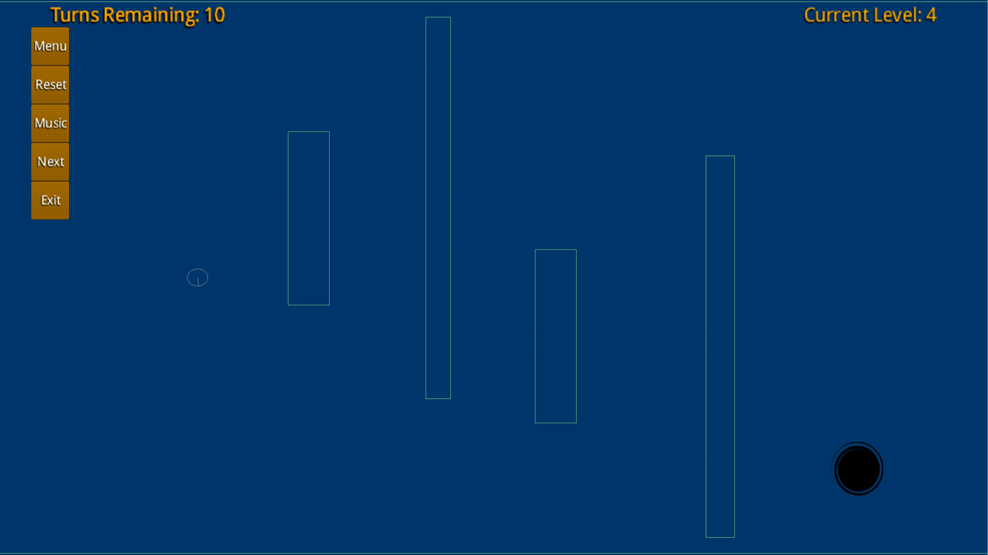
Player Experience Goals
The objective of the game is to move the player to the goal within the turn limit.
The game is a casual gaming experience with a major focus on puzzle and problem solving aspects
The player should be challenged and feel a sense of accomplishment at the completion of each level

Slide 5
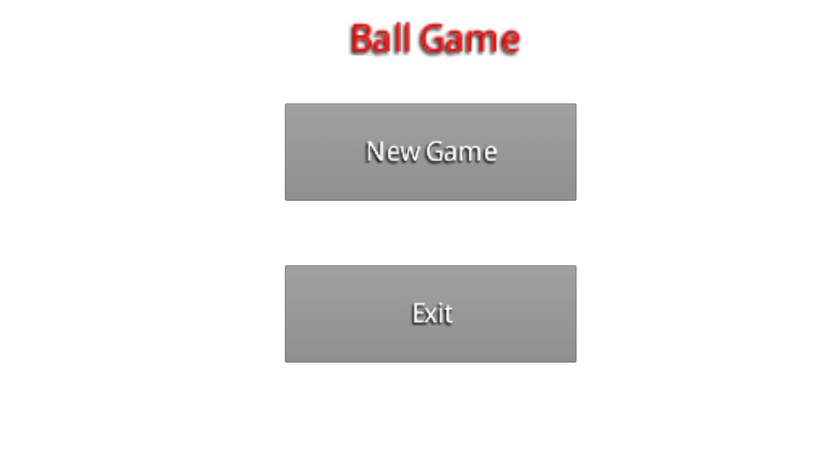
Play Testing Results
Play testing resulted in both positive and negative feedback
Play testers said they enjoyed the game and found it relaxing
Positive features highlighted were that it was simple yet challenging and it felt nostalgic
Negative feedback included the clarity, the slow pace and the background look

Slide 6
Play Testing
Play testing in the beginning revealed that the game play was too slow to maintain attention from the player
We solved this by making the ball rotate and move faster which in turn made a much better play experience
In later play tests we were told that the game was far more enjoyable and if we could fix the collision with the goal it would be fantastic
We remedied the issues with the goal by removing collision and just checking if the player was in a certain location
Play testers said that they enjoyed how it is deceptively challenging

Slide 7
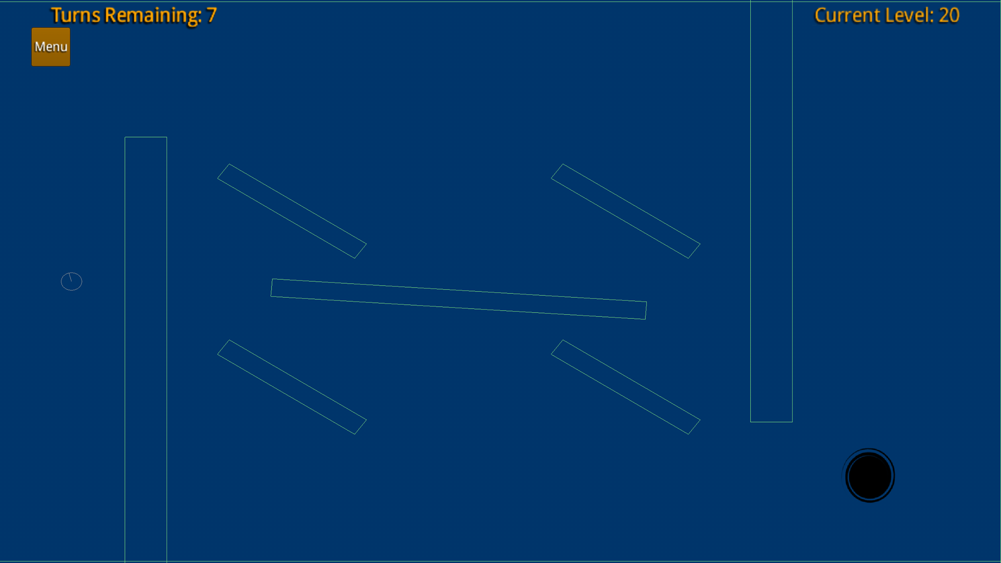
Game Construction
The games physics are based on the Box2D
The objects are all based on Box2D
The goal sprite was created using photoshop
The BGM was created using FL Studio

